Slide 1

GROUP PROJECT DIGITALIZATION OF BUSINESS PROCESSES
CASE: MEDICAL HEALTH INSURANCE
PC: Pixabay
Team Fete des Vignerons:
Lukasz Kaczmarek, Banujan Ragunathan, Andreas Hetschel and Grégory Witmer
Notes:
Banu

Slide 2

Agenda
What happened?
Pains
Scenario
General Process
Technical Implementation
Gains
Demo (Video)
Outlook
Notes:
Banu

Slide 3

What happened?
Cats are human companions for millennia
Approximately 1.8 million living in Swiss households
Cat try to get revenge on his owner because he forgets often to feed him.
Owner gets injured by falling cupboard
It caused several faces and skin injuries
Owner claims his medical insurance after staying in hospital
Source: Statistica PC: Lezebre
Notes:
Banu

Slide 4

Pains of Medical Health Insurance
Paperwork loaded process
Many user tasks and manual steps
Different lists to save information
Non-customers try to defraud MHI Insurance
Hospitals charge incorrect treatment with the wrong ICD and hospital stays
Notes:
Explain ICD / Real case from Banu’s working place
Banu

Slide 5

Scenario
Inspiration from pre-defined project cases and from the working place of project team member
Claim process from Medical Health Insurance (MHI)
Authenticate the customers and check the medical bills properly
Check if the medical case refers to claimed medical bill
Further medical investigation by the experienced Checkmedical (CM)
Example of treatment of a patient who gets injured by his cat
Notes:
Banu

Slide 6
General Process
Online form to add customer details and medical bill
System check details of customer and non-registered treated as potential customers
Calculation a percentage of the payment according to insurance type
ICD of medical bill checked automatically
Mail send to Checkmedical if the ICD does not relate to the case
Incorrect medical bill rejected, and customer and hospital and customer will be informed
Payment amount calculated according to insurance type and full amount
Customer and financial department informed about the release of the payment
Notes:
Greg

Slide 7
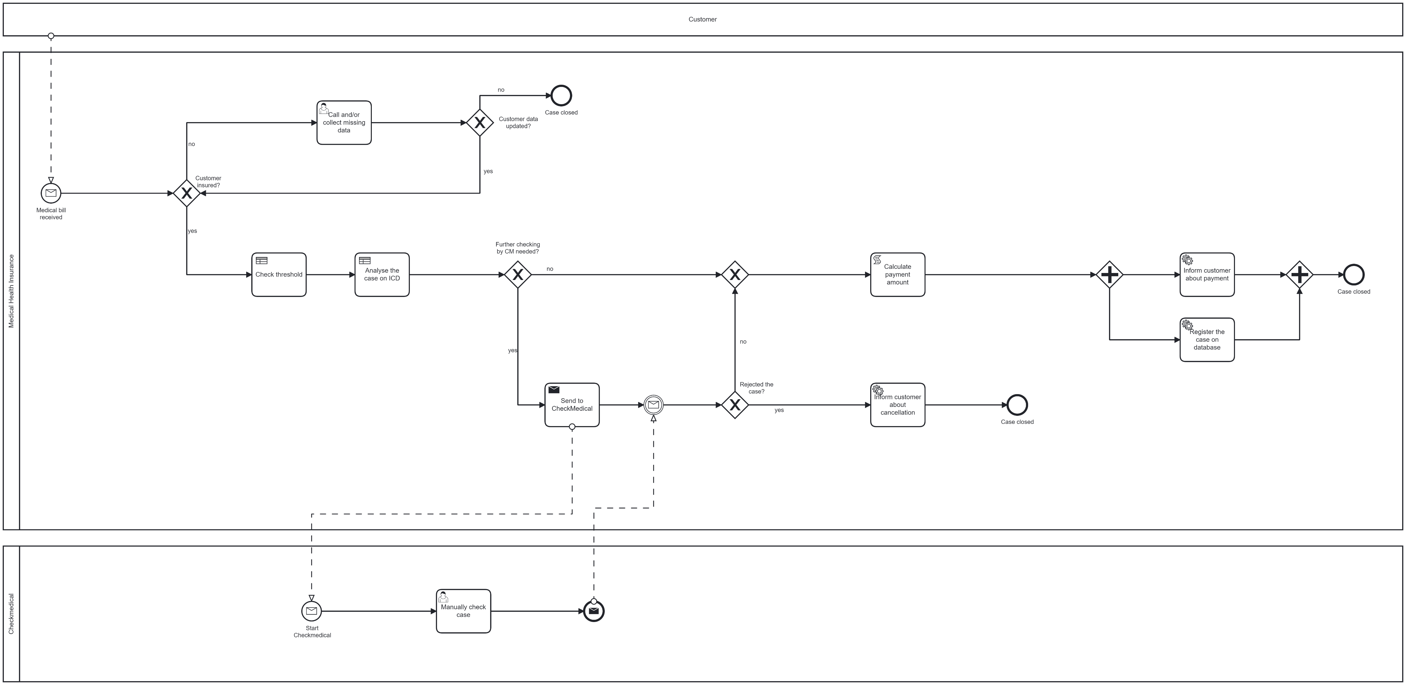
Notes:
Greg

Slide 8
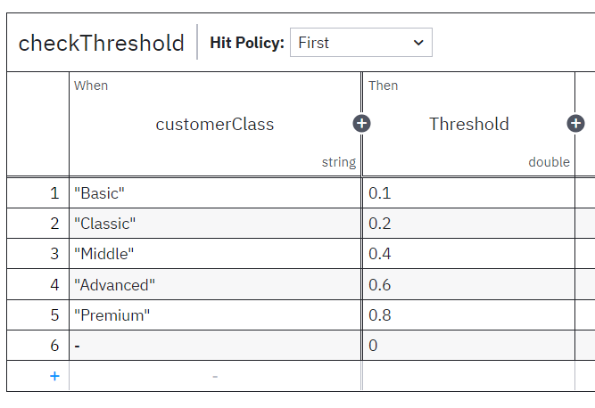
General Process
Customer policy type
Customer percentage of payment
Notes:
Greg

Slide 9
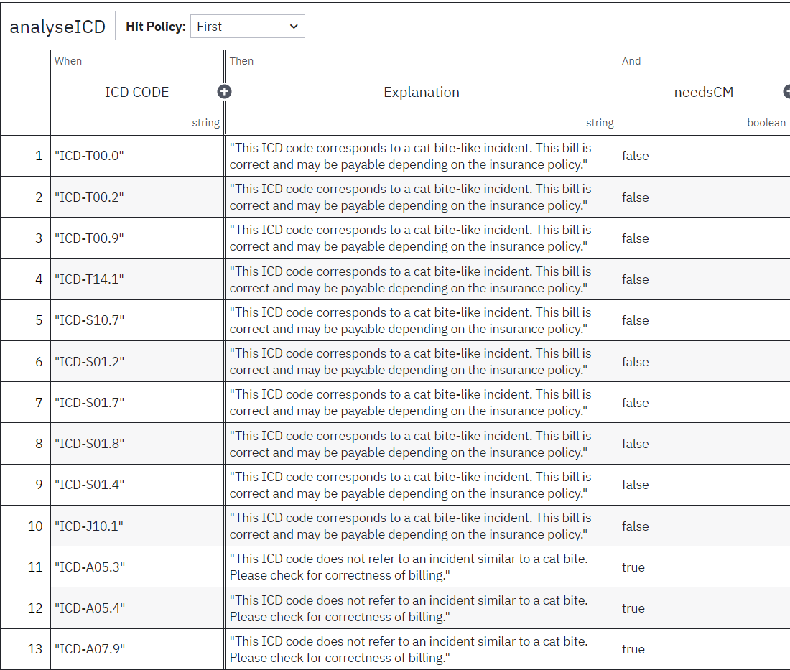
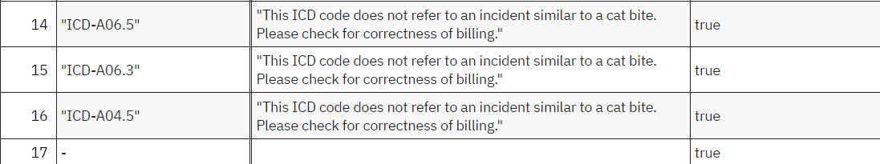
General Process
Notes:
Greg

Slide 10
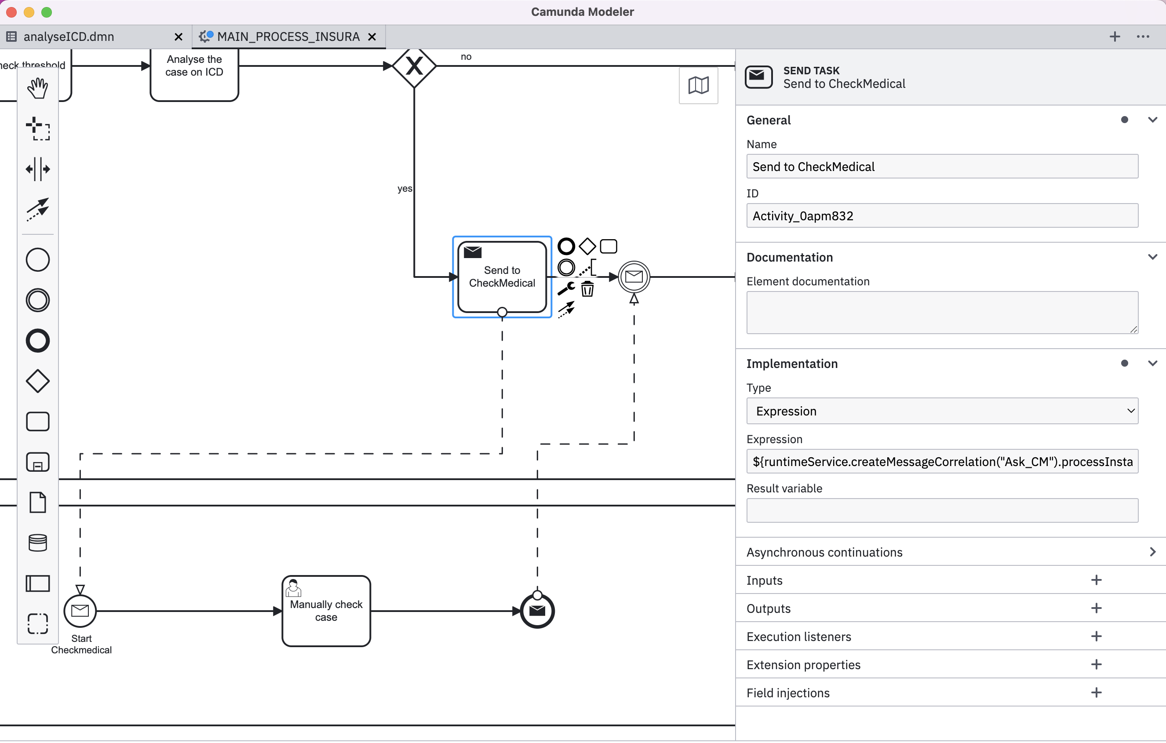
Technical Implementation (Inter-process communication)
Notes:
Lukas

Slide 11
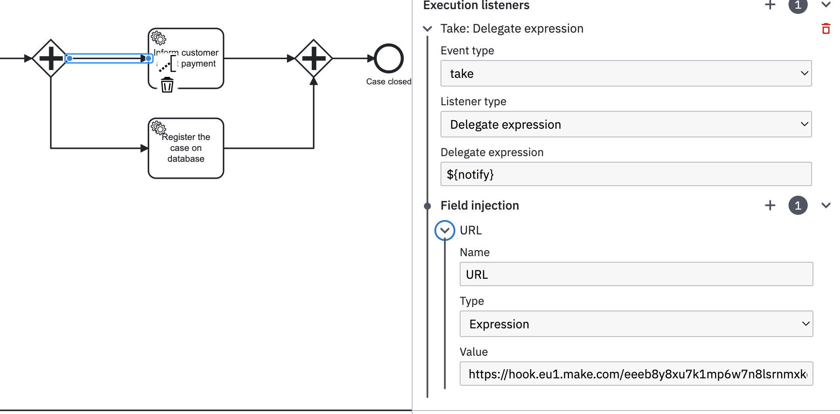
Technical Implementation (MAKE<->Camunda)
Notes:
Lukas

Slide 12
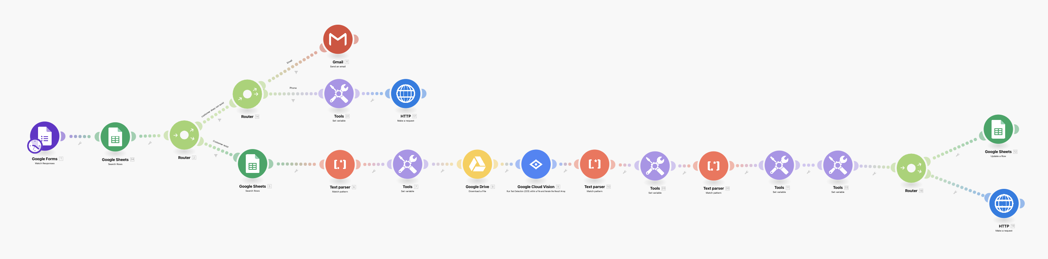
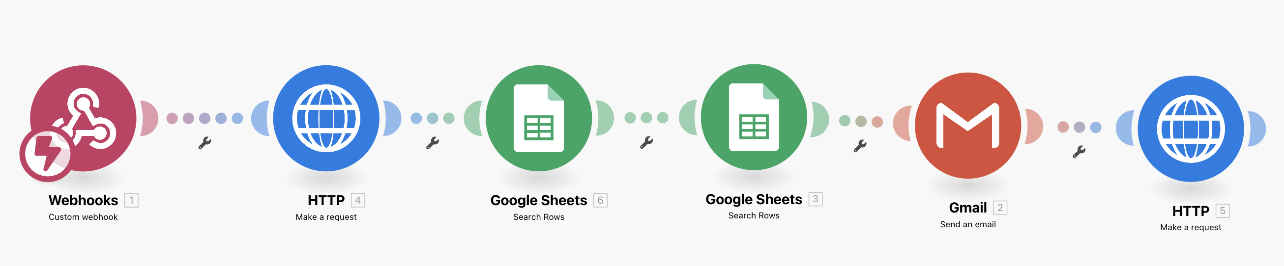
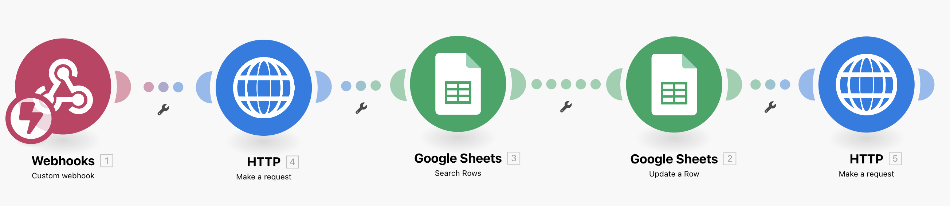
Technical Implementation
Notes:
GREG/LUKAS

Slide 13
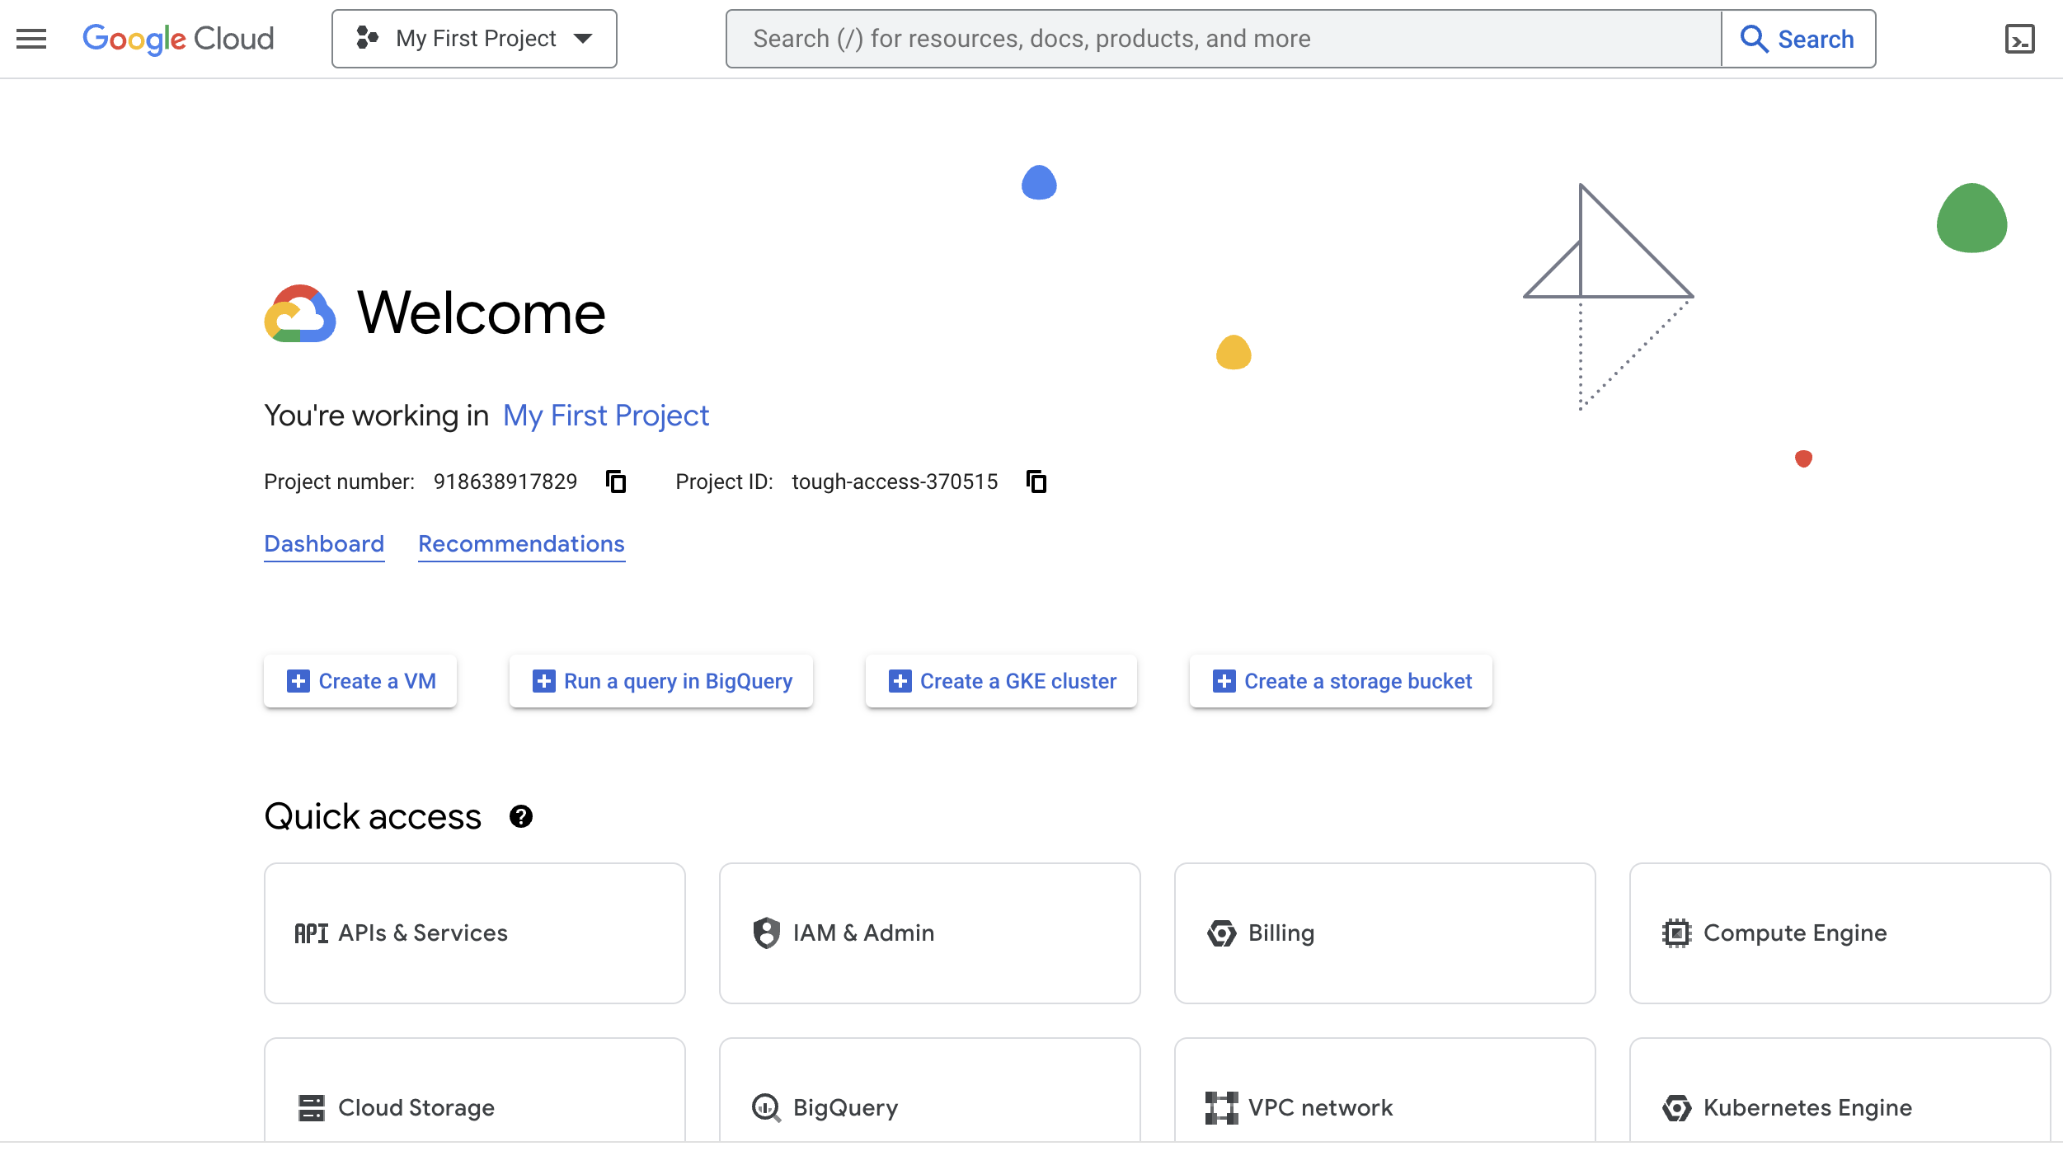





Technical Implementation
Notes:
Lukas

Slide 14
Gains for Medical Health Insurance
REFERRED TO CASE:
Customer involved in the process and regularly informed
Application form with saved information
Authentication of Customer
Automated check of ICD on reliability
If required automated clarification from Checkmedical
Automated calculation of payment amount
Automated Trigger for several steps for example release of payment
GENERAL POINTS:
Time savings
More cases handled in a short period
Development with simple tools
Notes:
Andy

Slide 15

Demo (Video)
PC: Freepik
Notes:
Andy

Slide 16
Outlook
Advancement of current Digitalisation
Involving more user tasks in automated task
One database for all information with SQL
Advanced check of ICD (real case with more ICDs)
Calculate the final amount by more variables
Involve partner steps in own process
Notes:
Andy

Slide 17

Questions
PC: Freepik
Notes:
Andy

Slide 18
THANK YOU
from Lukasz Kaczmarek, Banujan Ragunathan, Andreas Hetschel and Grégory Witmer
Notes:
Andy

